Slide 1
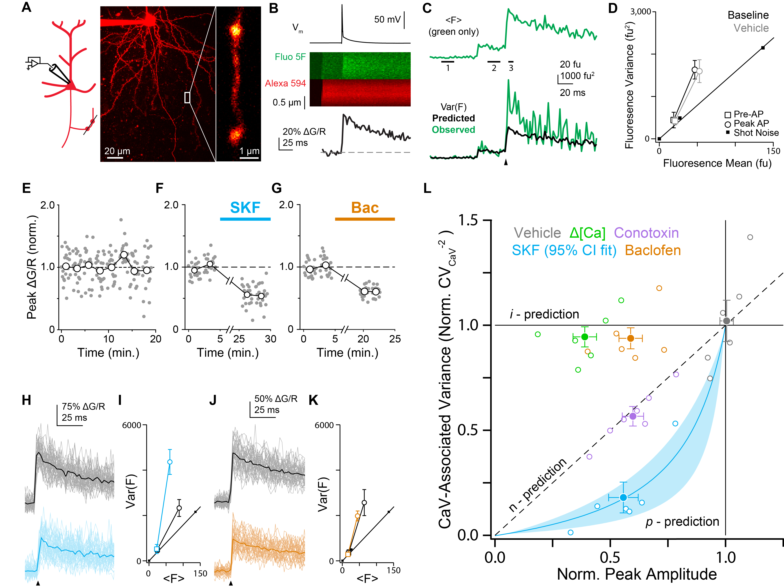

Presynaptic mechanisms for modulating synaptic gain
Ken Burke
Bender Laboratory
Department of Neurology
UCSF
Notes:
New insights into the neuromodulation of transmitter release

Slide 2
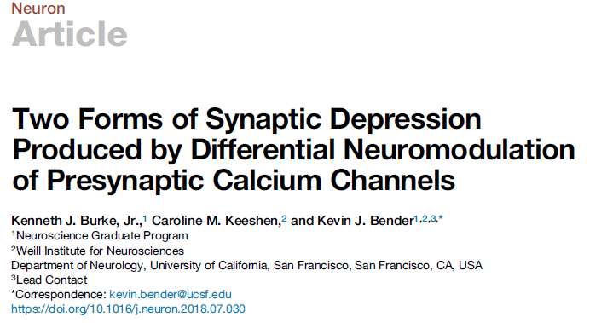
Presynaptic mechanisms for modulating synaptic gain
Ken Burke
Bender Laboratory
Department of Neurology
UCSF
Notes:
New insights into the neuromodulation of transmitter release

Slide 3
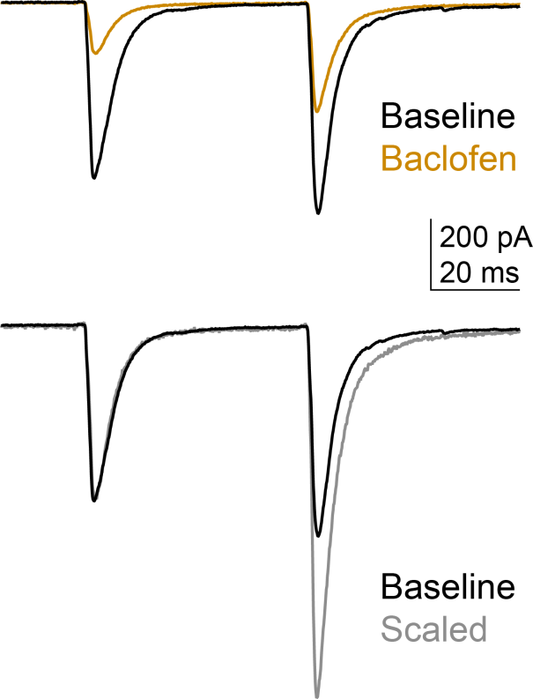
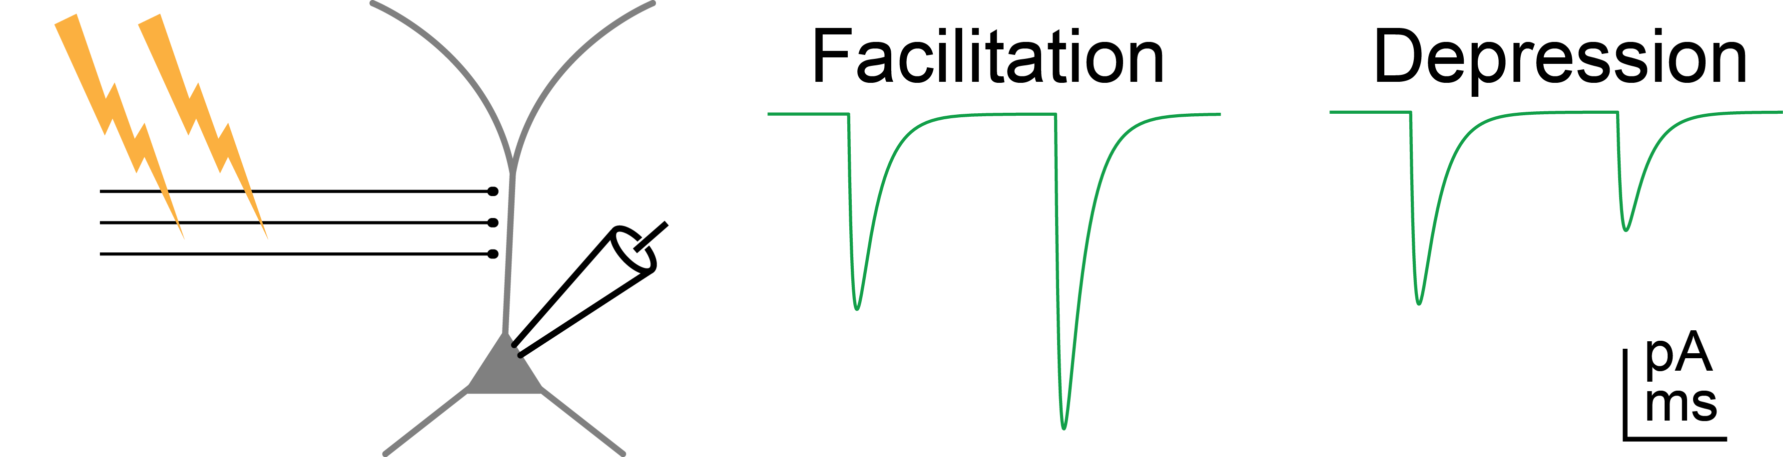
Neuromodulators that lower release probability (P_{R}) typically increase paired pulse ratio (PPR)
Notes:
Neuromodulators are capable of changing synaptic strength by modulating the probability of neurotransmitter release, Pr. According to canon, reductions in Pr are often thought to accompany increases in the paired-pulse ratio, or PPR, which you can see here with activation of the GABAB receptor with the drug Baclofen. However, PPR is not only a useful metric for identifying the locus of action for neuromodulators, but also points to a common computational transformation that presynaptic neuromodulators engage. By preferentially suppressing the first pulses in a burst of input, this change in PPR leads to high-pass filtering of the synapse

Slide 4
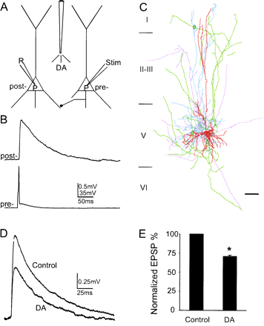
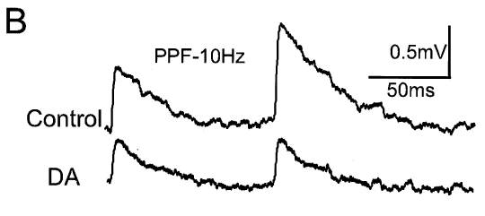
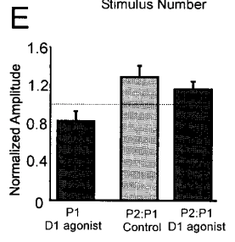
Dopamine seems to break this rule in PFC…
Gao et al., 2001 PNAS

Slide 5
… and dopamine is not the only exception.
D1R: Stim electrode, mPFC
Seamans et al., 2001
D1R: Pairs, mPFC
Gao et al., 2001
D1R: perforant path, subiculum
Behr et al., 2000
Kappa opiod: CeA→BNST , Li et al., 2012
BLA→Nacc, Tejeda et al., 2017
α2 adrenoceptors: Amyg→brainstem
Delaney et al., 2007
Inhibitory (depressing) synapse:
Hefft et al, 2002
Gao et al., 2001 PNAS

Slide 6
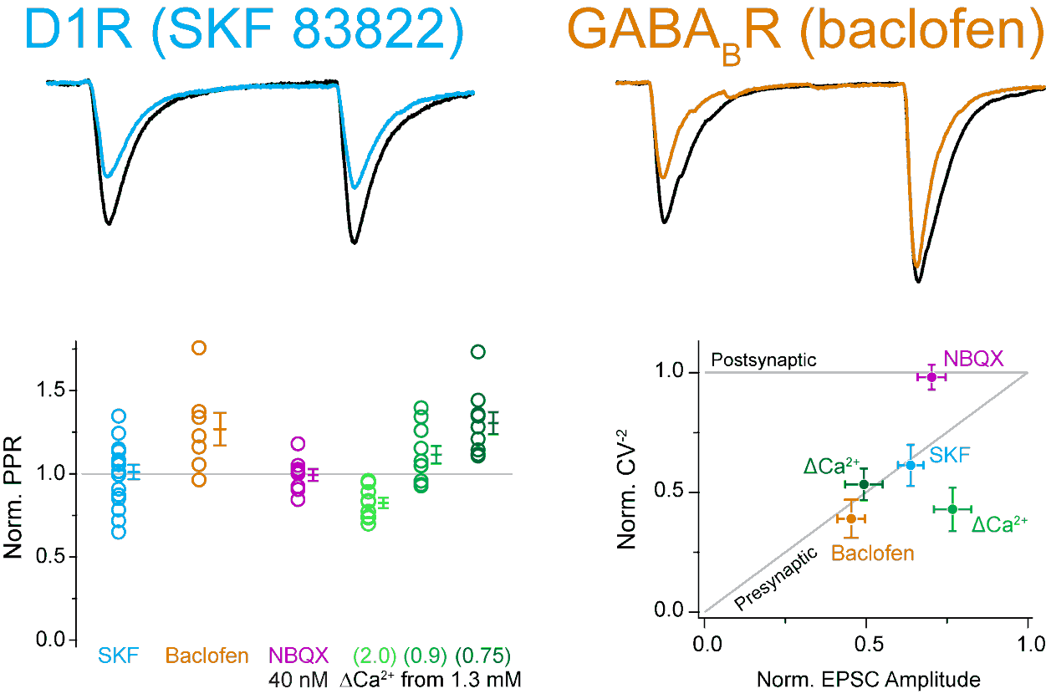
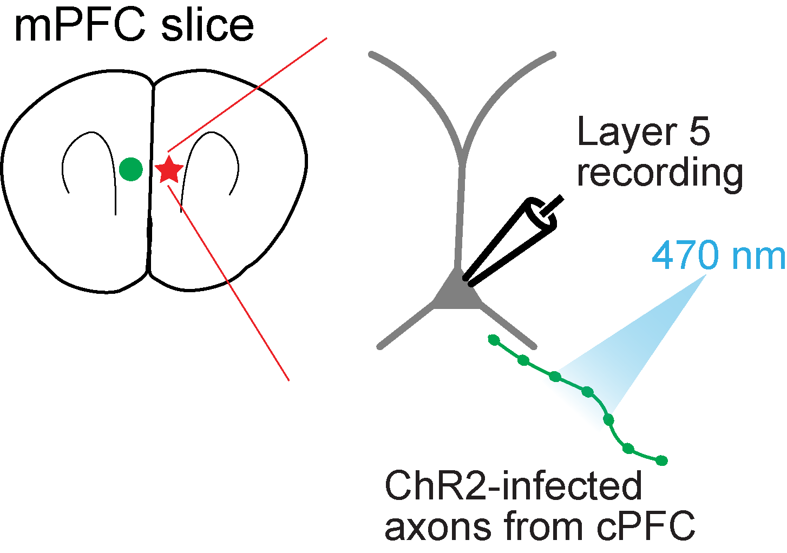
Canonical (GABA_{B}R) and non-canonical (D1R) modulation both occur at contralateral inputs to PFC
Burke, Keeshen, & Bender 2018 Neuron

Slide 7
Canonical (GABA_{B}R) and non-canonical (D1R) modulation both occur at contralateral inputs to PFC
Burke, Keeshen, & Bender 2018 Neuron

Slide 8
Canonical (GABA_{B}R) and non-canonical (D1R) modulation both occur at contralateral inputs to PFC
Burke, Keeshen, & Bender 2018 Neuron

Slide 9
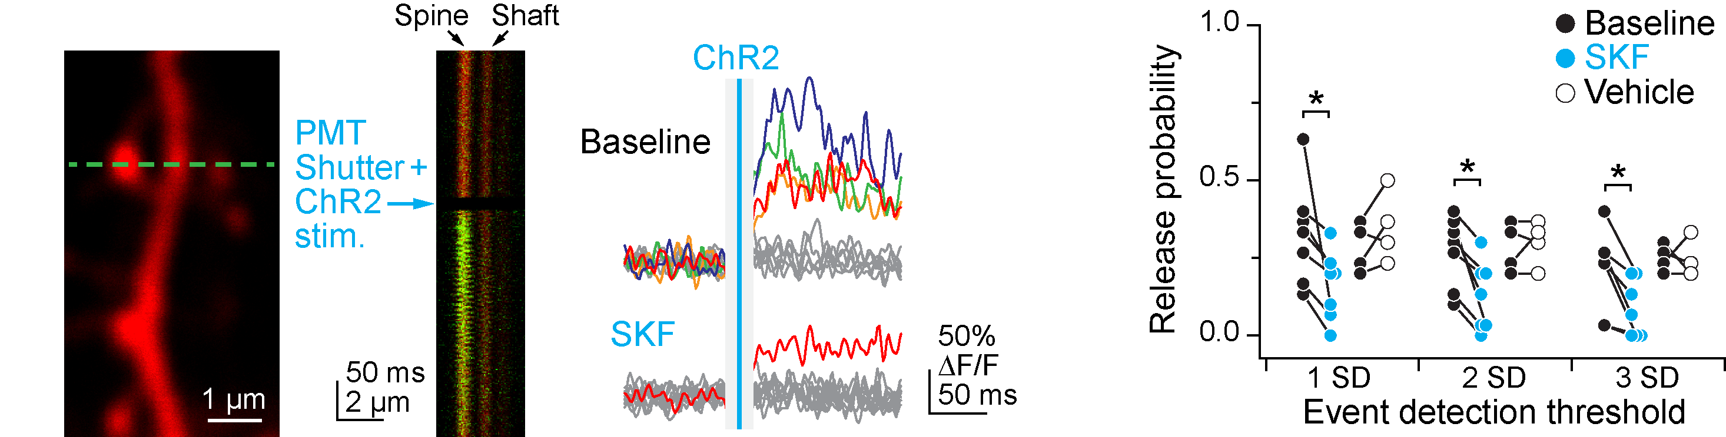
If this is really presynaptic, we should see a reduction in release probability at single synapses

Slide 10
If this is really presynaptic, we should see a reduction in release probability at single synapses

Slide 11
D1R activation suppresses presynaptic calcium influx

Slide 12
D1R activation suppresses presynaptic calcium influx

Slide 13
D1R activation suppresses presynaptic calcium influx

Slide 14
What presynaptic mechanisms could suppress release with distinct effects on PPR?
Notes:
So now we have a mechanism by which D1Rs decrease presynaptic calcium influx and thus reduce release probability, but do NOT increase PPR, even when GABAB increases PPR at the same synapse. What mechanisms could result in this difference?

Slide 15
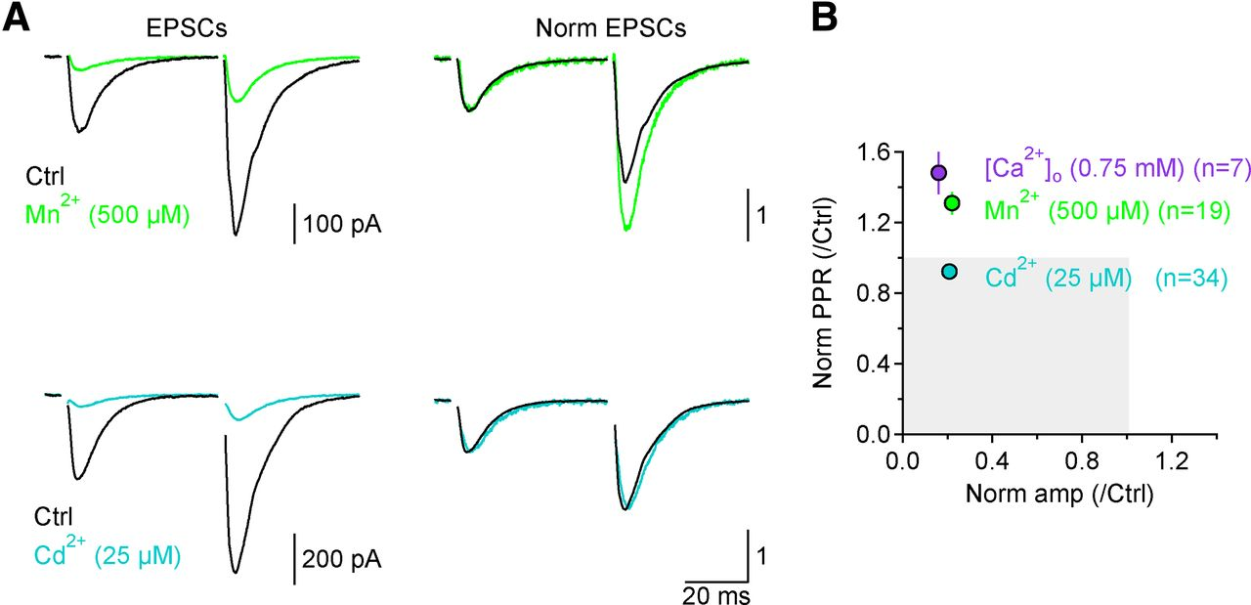
At Schaffer collateral synapses, two CaV antagonists suppress release with different effects on PPR
Scimemi and Diamond, 2012
J Neurosci
Notes:
The critical insight came from Scimemi and Diamond, 2012, who found that at Schaffer collateral synapses, two different calcium channel antagonists with different kinetics also decreased release probability with different effects on the paired-pulse ratio. As you see here, the fast “flicker-blocker” Manganese increases PPR like GABAB, whereas the slow antagonist Cadmium does not change PPR much like the D1 receptor. This led us to hypothesize that maybe the difference between GABAB and D1R on presynaptic calcium influx mirrors the difference between cadmium and manganese!

Slide 16
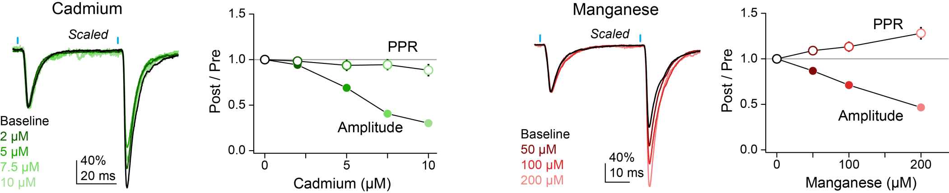
Similar effects occur at mPFC synapses
Burke, Keeshen, & Bender 2018 Neuron
Notes:
And indeed we found that this difference, where cadmium does not increase PPR but manganese does, is found at our synapses in PFC as well.

Slide 17
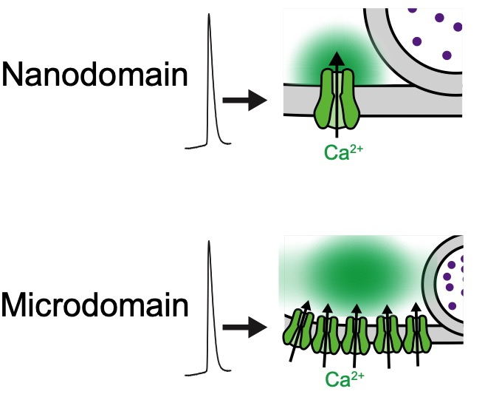
Cd²⁺ and Mn²⁺ effects due to CaV-vesicle coupling dynamics
(~1 CaV per vesicle)
(>1 CaVs per vesicle)
Notes:
So why do cadmium and manganese have different effects on release in the first place? To understand this, we need to consider how presynaptic calcium channels couple to vesicles.

Slide 18
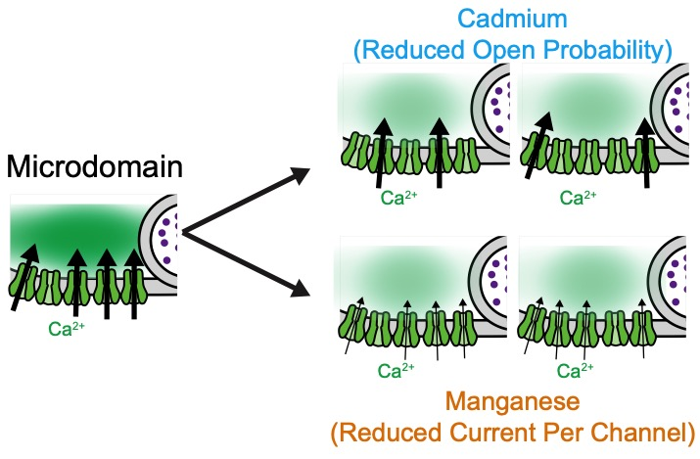
Cd²⁺ and Mn²⁺ effects due to CaV-vesicle coupling dynamics
Notes:
Let’s consider the microdomain case first. Cadmium, because it’s dissociation is quite slow relative to the duration of an action potential, should functionally reduce the probability a calcium channel opens. In the case of a microdomain with many channels, this leads to a graded reduction in overall calcium influx. Manganese, however, dissociates much faster than an AP, and so should reduce current through individual channels. But in the microdomain case, this still leads to the same end result of less intracellular calcium.

Slide 19
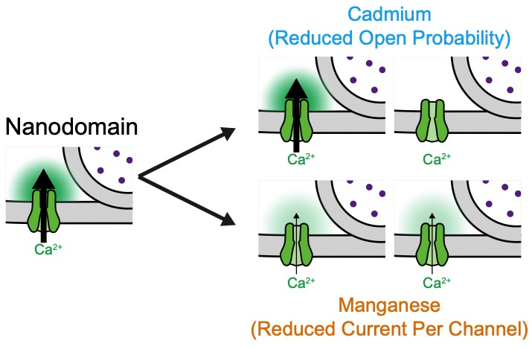
Cd²⁺ and Mn²⁺ effects due to CaV-vesicle coupling dynamics

Slide 20
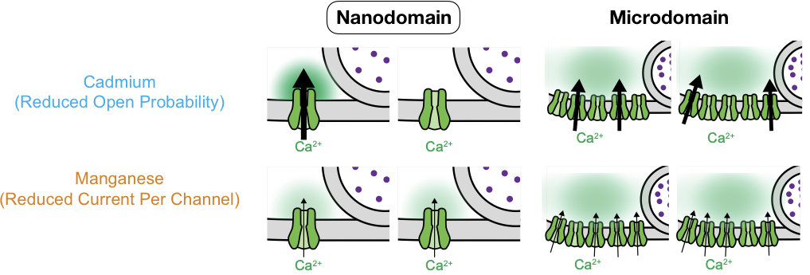
Cd²⁺ and Mn²⁺ effects due to CaV-vesicle coupling dynamics
There’s only a difference for the nanodomain.
Cd & D1R don’t increase PPR, but Mn & GABA do.
Does D1R reduce CaV open probability, and GABA reduce CaV current?

Slide 21
Imaging CaV fluctuations to determine modulatory mechanisms
Biological noise
Rig noise
Based on:
Sabatini and Svoboda, 2000 Nature
Yasuda et al., 2003 Nat Neurosci
Carter and Jahr, 2016 Nat Neurosci

Slide 22
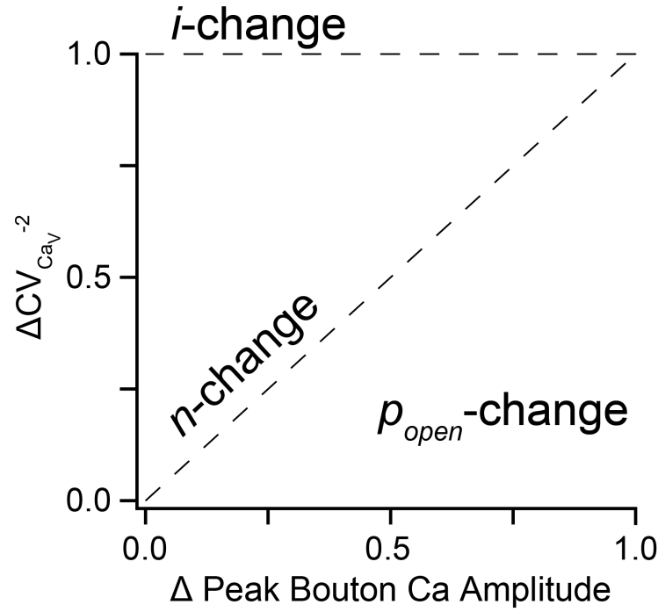
Imaging CaV fluctuations to determine modulatory mechanisms
Predictions at boutons:
Biological noise
Rig noise
Based on:
Sabatini and Svoboda, 2000 Nature
Yasuda et al., 2003 Nat Neurosci
Carter and Jahr, 2016 Nat Neurosci

Slide 23
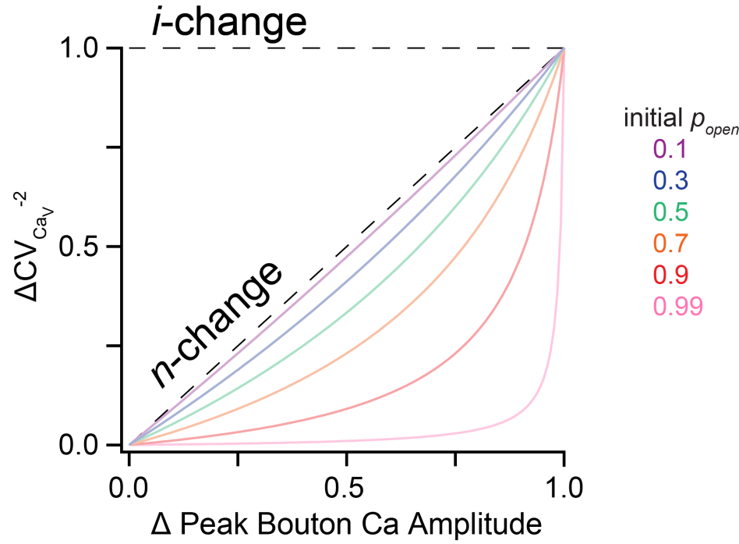
Imaging CaV fluctuations to determine modulatory mechanisms
Predictions at boutons:
Biological noise
Rig noise
Based on:
Sabatini and Svoboda, 2000 Nature
Yasuda et al., 2003 Nat Neurosci
Carter and Jahr, 2016 Nat Neurosci

Slide 24
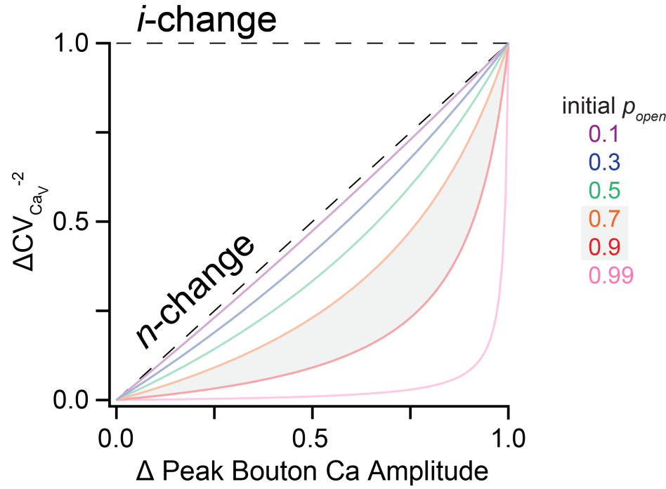
Imaging CaV fluctuations to determine modulatory mechanisms
Predictions at boutons:
Biological noise
Rig noise
Based on:
Sabatini and Svoboda, 2000 Nature
Yasuda et al., 2003 Nat Neurosci
Carter and Jahr, 2016 Nat Neurosci

Slide 25
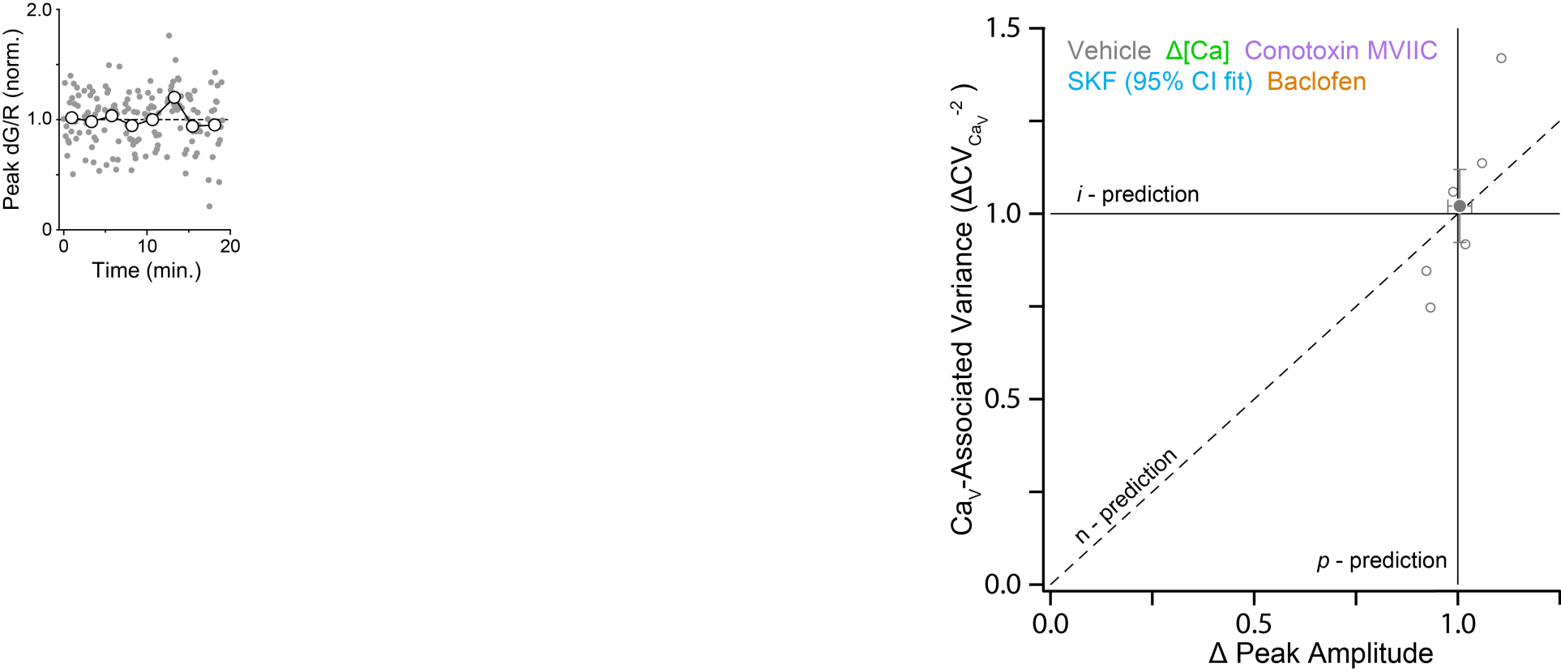
AP-evoked bouton Ca transients are stable over time

Slide 26
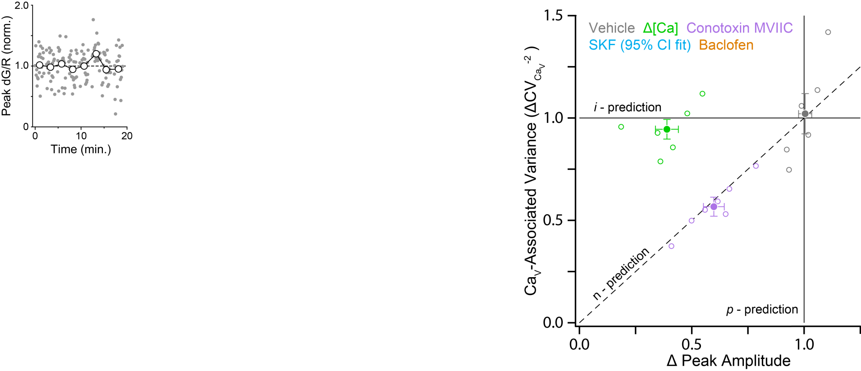
Manipulations of i and n work as expected

Slide 27
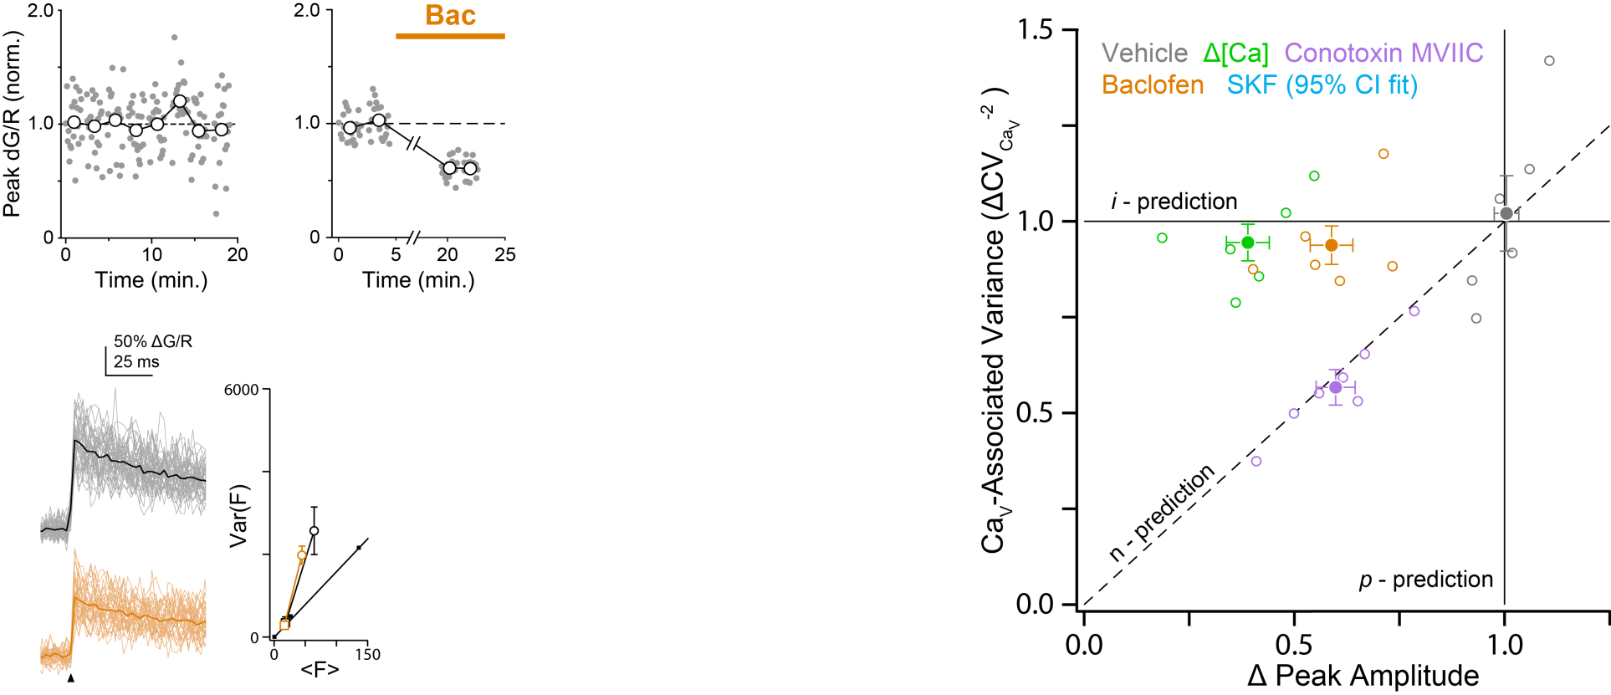
GABA_{B}R activation reduces Ca influx per AP

Slide 28
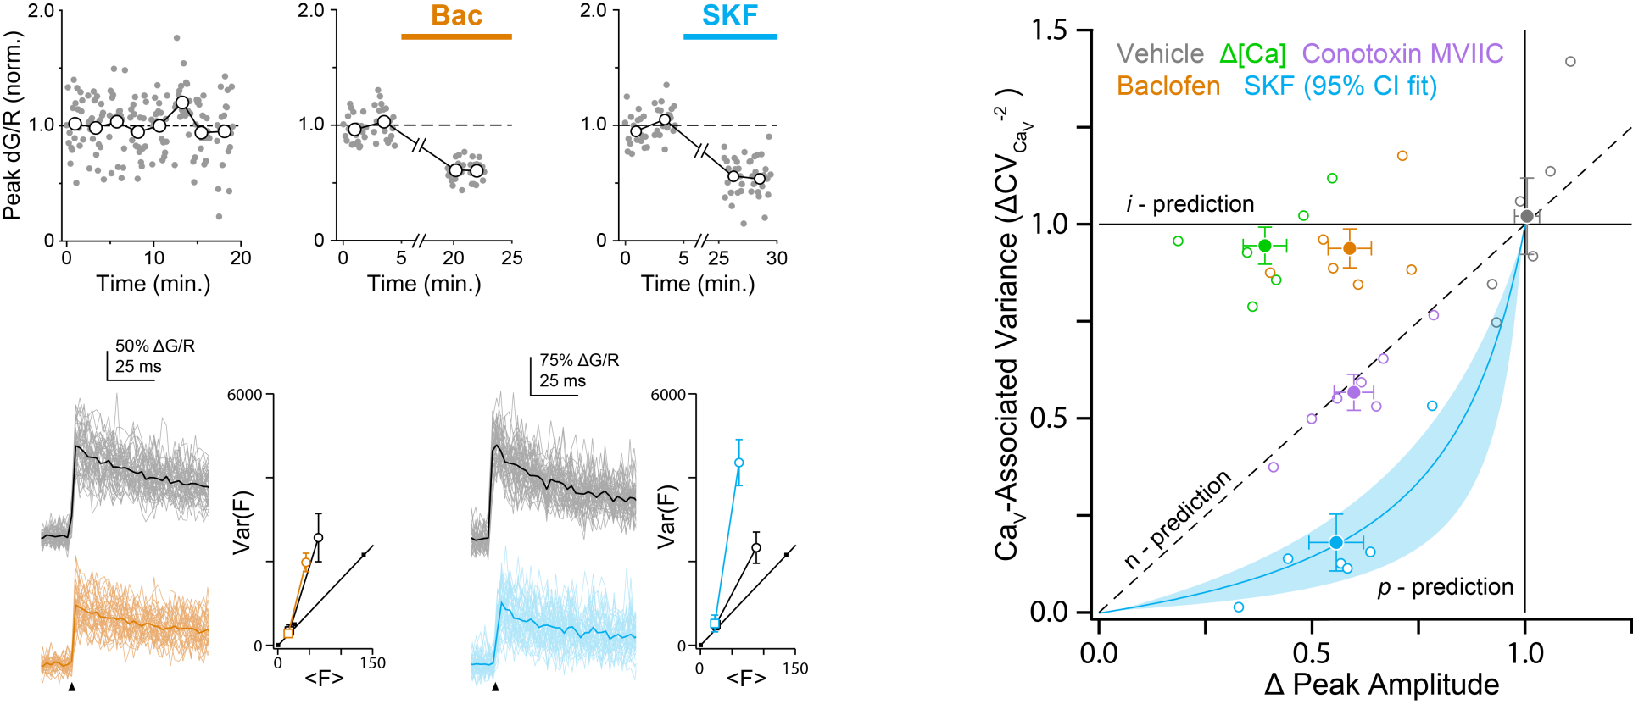
D1R reduces probability of CaV opening per AP
CaVs modulated by dopamine or GABA respond differently to AP stimuli

Slide 29
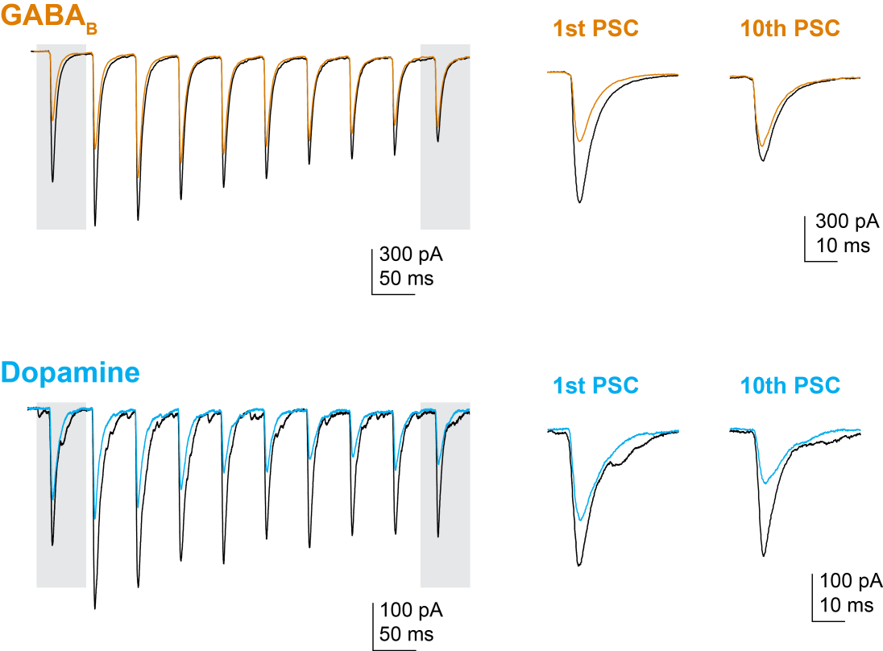
Traditional presynaptic modulators act as high-pass filters

Slide 30
Dopamine is anything but a high-pass filter

Slide 31
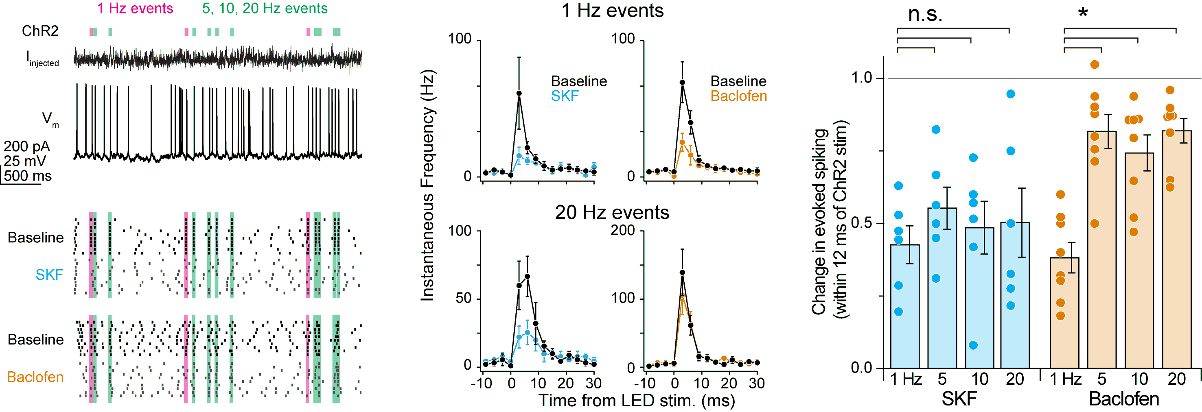
How does this affect information transfer?

Slide 32
How does this affect information transfer?

Slide 33
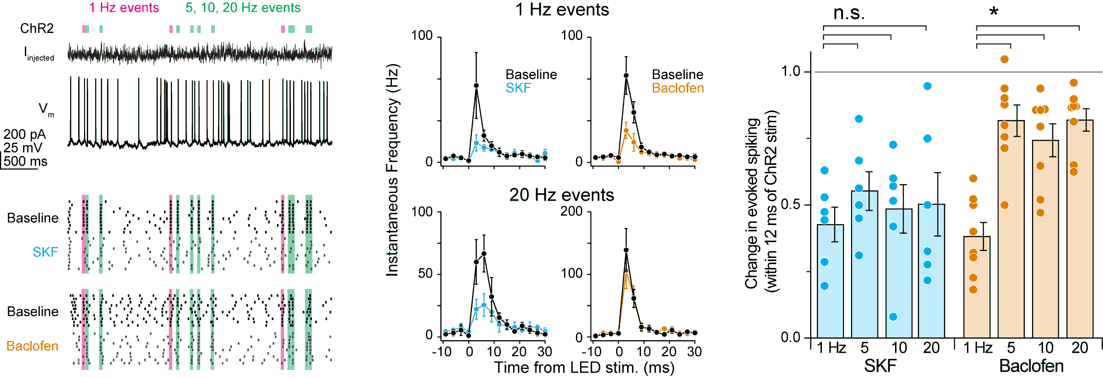
D1R is frequency independent, GABA_{B}R is a high-pass filter

Slide 34
Conclusions:
Neuromodulators can have biased effects on CaVs that support transmitter release.
At nanodomain synapses, altering CaV open probability (per AP) can suppress release without high/low-pass filtering.
If a PPR experiment “fails”, it might not be your fault.

Slide 35



Acknowledgements
Caroline Keeshen Kevin Bender, PhD Jiggy Athilingam, PhD Anna Lipkin Perry Spratt Becky Clarkson, PhD Roy Ben-Shalom, PhD

